Slide 1
ARHOME Economic Independence Incentives 2022
Matthew Vannatta, VP Consumer and Retail Markets
June 27, 2023

Slide 2
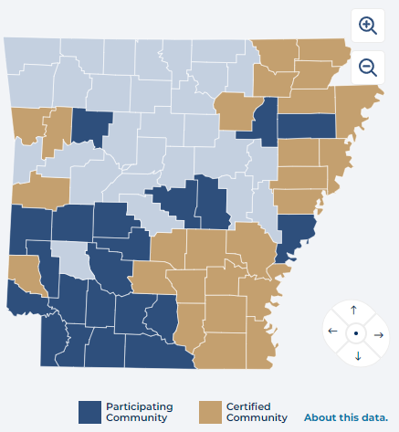
Arkansas Career Readiness Certificate Incentive
The Career Readiness Certificate (CRC) measures and certifies the essential work skills needed for success in jobs across industries and occupations.
ABCBS incentivizes completion of the CRC to allow ARHome members to be more marketable in the workforce, allowing members to build confidence and showcase their skills for better employment opportunities. The CRC also helps to determine training needs and to earn college credit at many institutions.
The CRC is no cost and is recognized nationally.
The state of Arkansas has 26 certified communities and 47 participating communities with a total of 103,406 earned CRCs.
The CRC is earned by completing the three WorkKeys Assessments for applied math, workplace documents, and graphic literacy.
ABCBS rewards based upon the level achieved overall:
CRC Score on all 3 skill areas | ABCBS Reward
Platinum+ (level 7 or higher) | $65
Platinum (level 6 or higher) | $55
Gold (level 5 or higher) | $45
Silver (level 4 or higher) | $35
Bronze (level 3 or higher) | $25

Slide 3
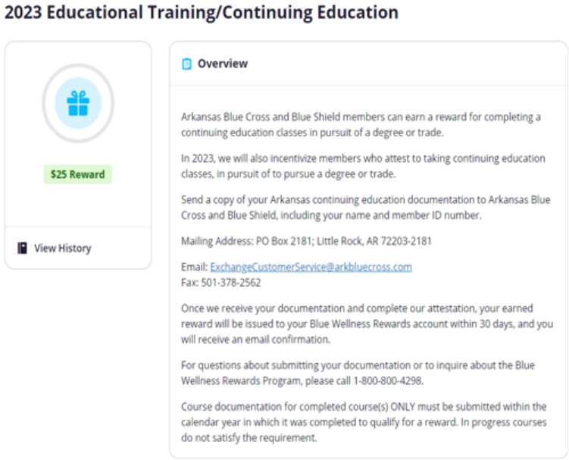
New for 2023: Educational Training/Continuing Education Incentive
To increase member engagement and to improve marketability of ARHome members in the workforce, ABCBS has added a reward for completing a continuing education class in pursuit of a degree or trade.
This can be done once each year.
Members send in their proof of educational class and earn $25.

